Slide 1






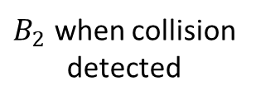

$$\vec{v}$$
$B_{2}$ when collision
detected
$$\vec{c}$$
$$B_{1}$$
$$θ$$
$$d$$
$B_{2}$ at TOI
$$δ$$

Slide 2









$\vec{v}$=[$v_{x}$, $v_{y}$]
$$[p_{x},p_{y}]$$
$$d_{1}$$
$$p_{y}−w_{y}$$
POI
$$θ$$
$$θ$$
$$y=w_{y}$$
$$d_{2}$$
$$r$$

Slide 3








$\vec{v}$=[$v_{x}$, $v_{y}$]
$$[p_{x},p_{y}]$$
POI
$$y=w_{y}$$
$$p_{y}−w_{y}+r$$
$$r$$
$$p_{y}−w_{y}+r$$
$$\vec{p}′$$
$\vec{v}$’=[$v_{x}$, $-v_{y}$]

